Slide 1
Simulated Virtual Restaurant
Café de Silva

Slide 2
Goals and Objectives
Explore how three-dimensional computer modeling is being utilized to aid restaurant creation and development.
Identify the advantages and barriers associated with virtual restaurant modeling and simulation
Develop a pilot project to examine modeling and simulation through a VRE (Virtual Restaurant Environment)

Slide 3
VRML and Modeling
Planned Development
Animations
Behaviors and Functionality
Sensors

Slide 4
Planned Development
A restaurant displayed within a night setting modeled to encompass a complete interior and exterior scene with four floors.
A detailed building (textures, lighting, etc.) with a café lounge at the entrance floor.
Incorporate VRML behaviors and functionalities through 3Ds Max.

Slide 5
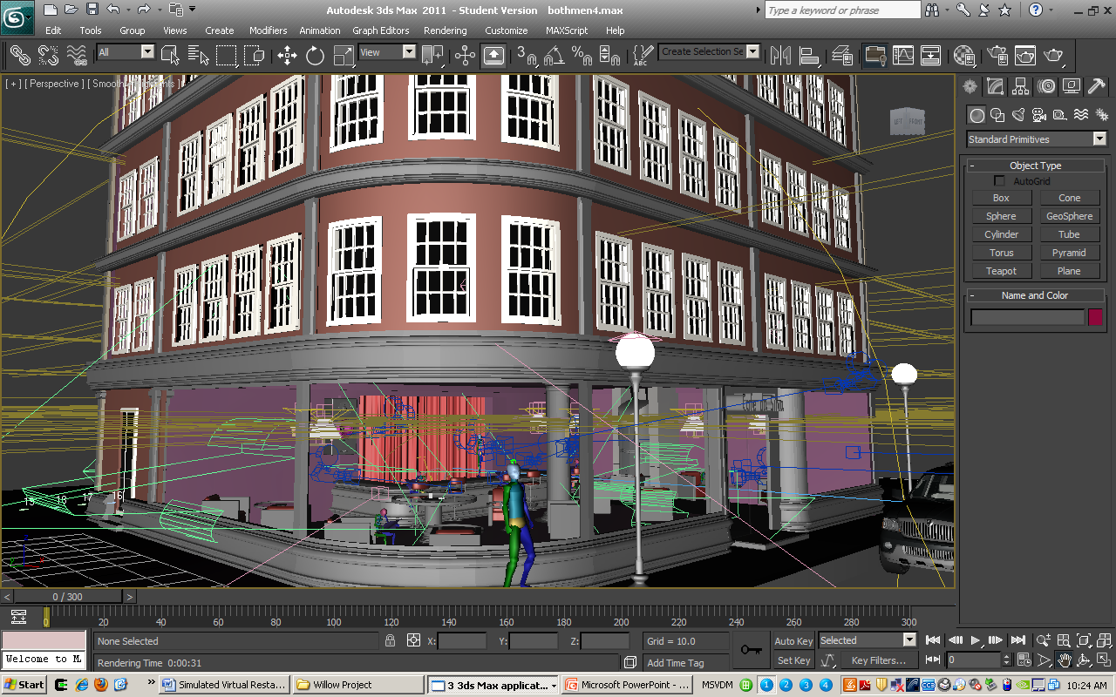
Café de Silva

Slide 6
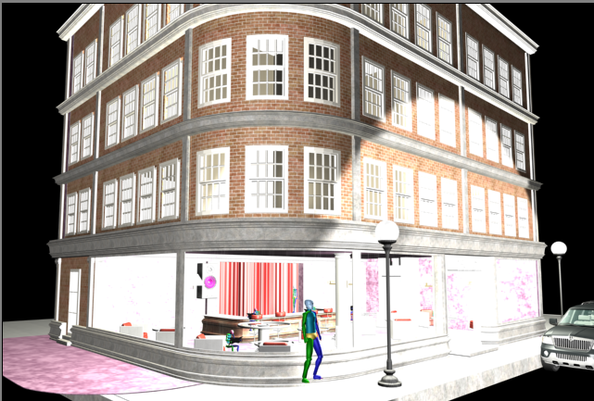
Café de Silva

Slide 7
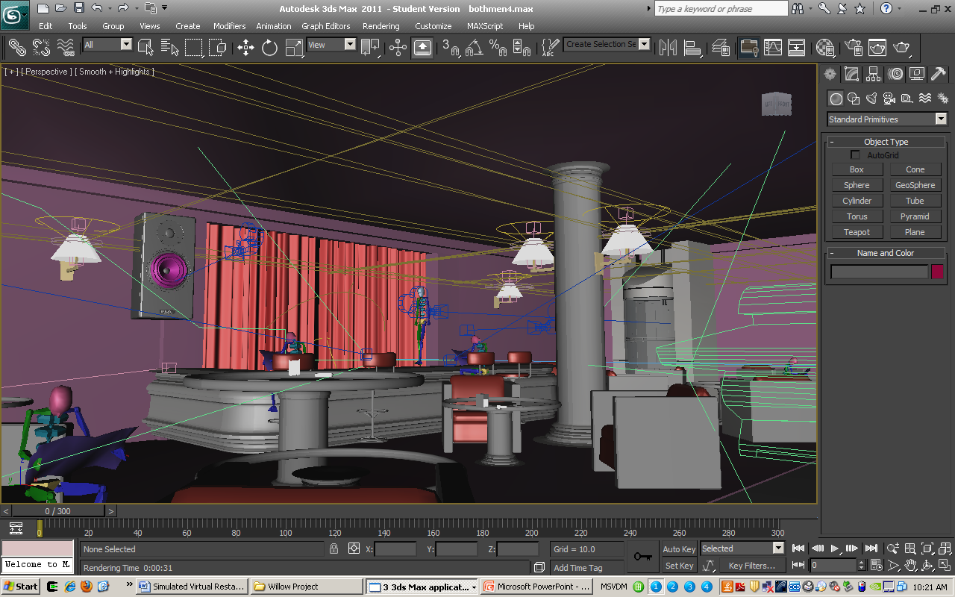
First Floor

Slide 8
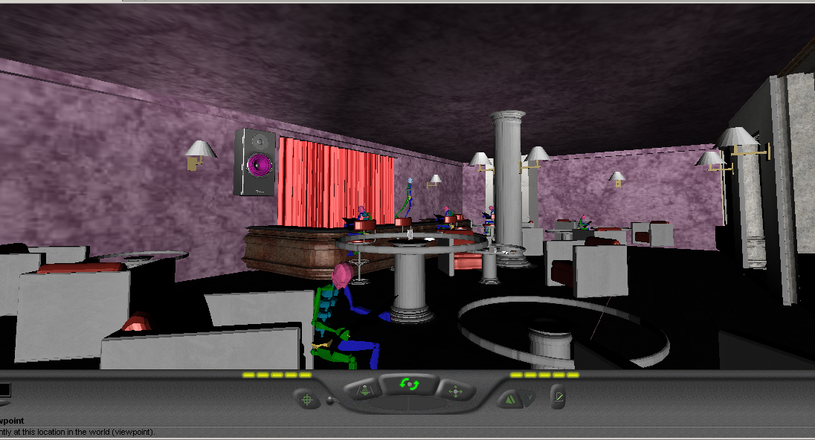
First Floor

Slide 9
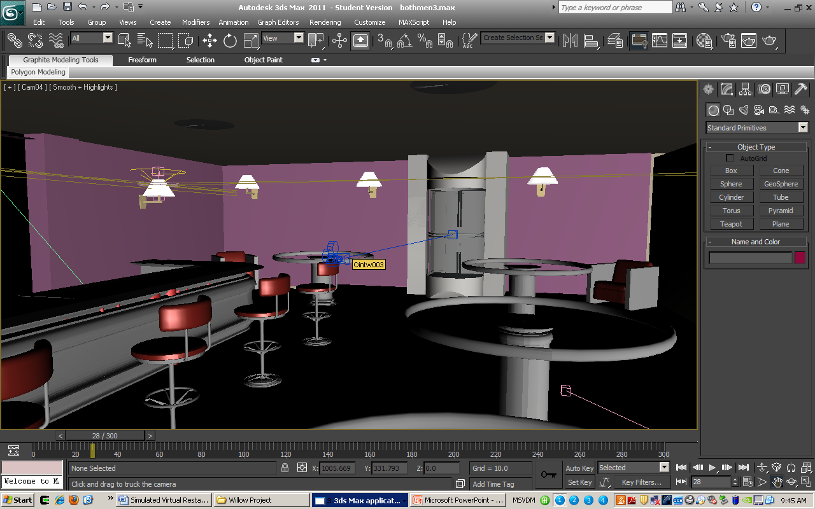
Second Floor

Slide 10
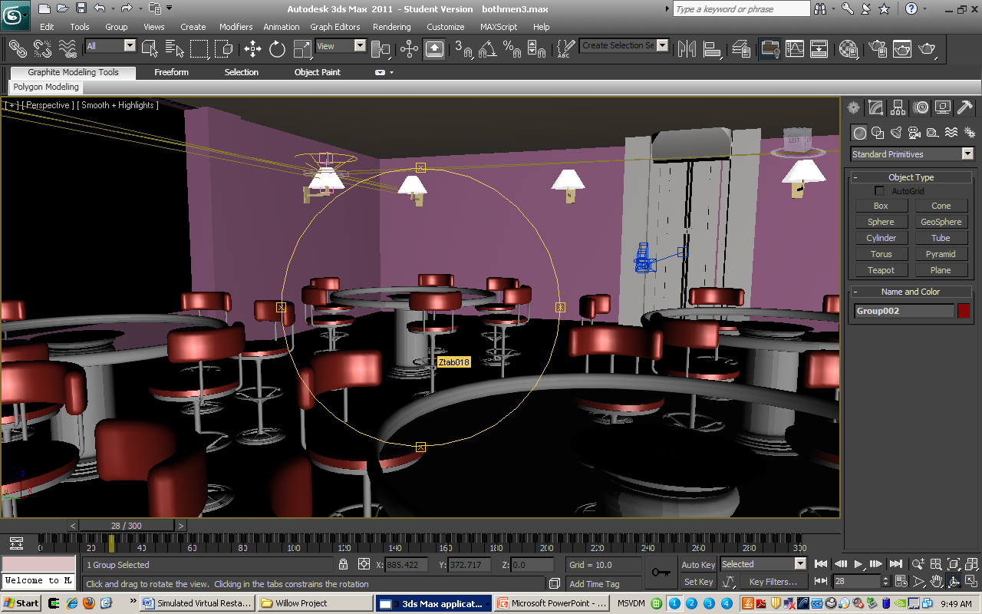
Third Floor

Slide 11
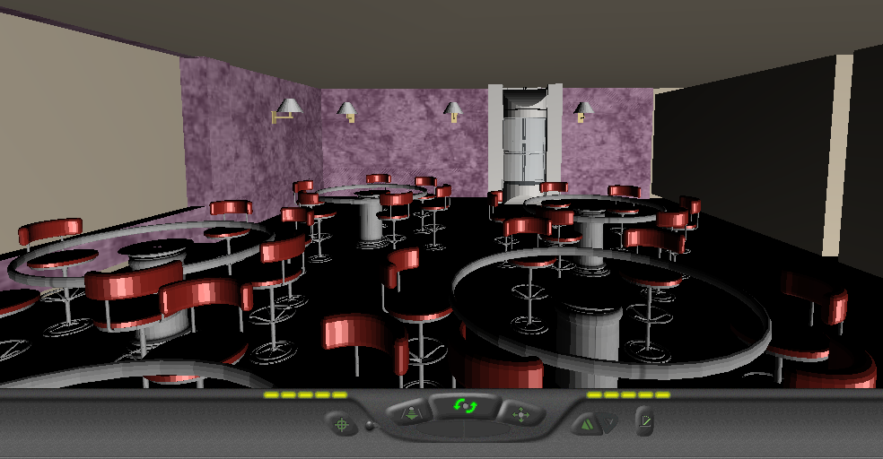
Third Floor

Slide 12
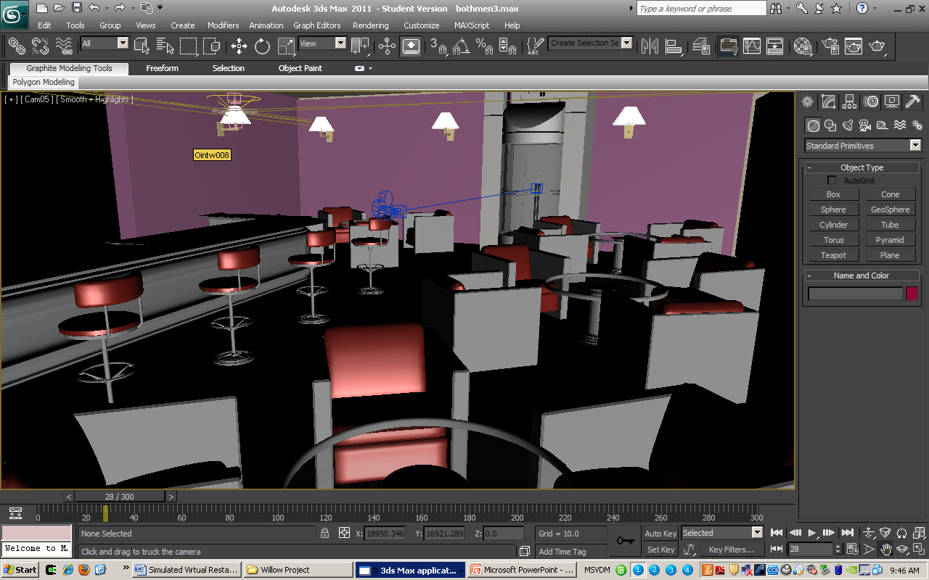
Fourth Floor

Slide 13
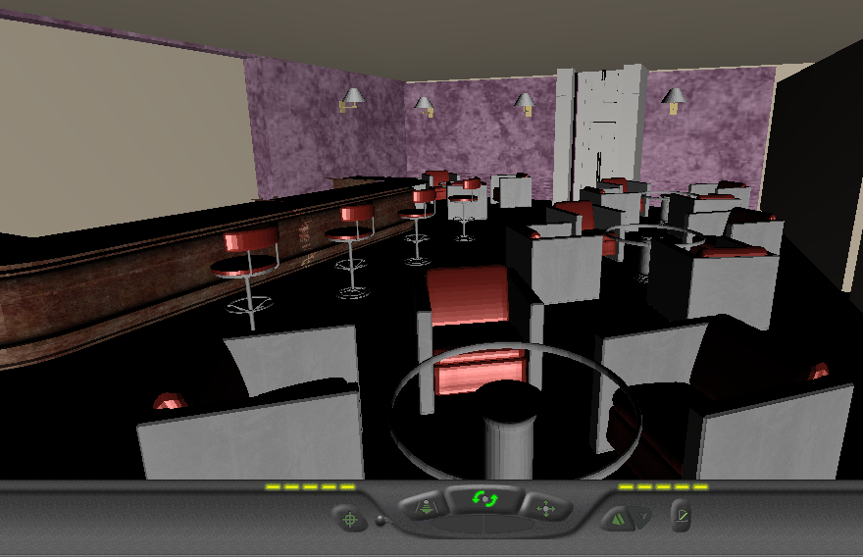
Fourth Floor

Slide 14
Animation
Biped
Speaker
Vehicle
Elevator
Furniture

Slide 15
Biped

Slide 16
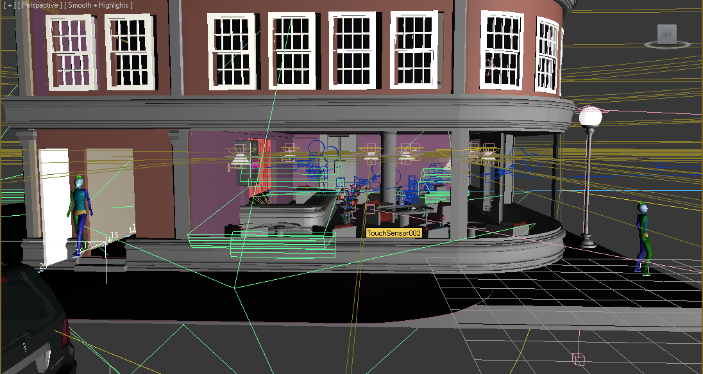
Biped

Slide 17
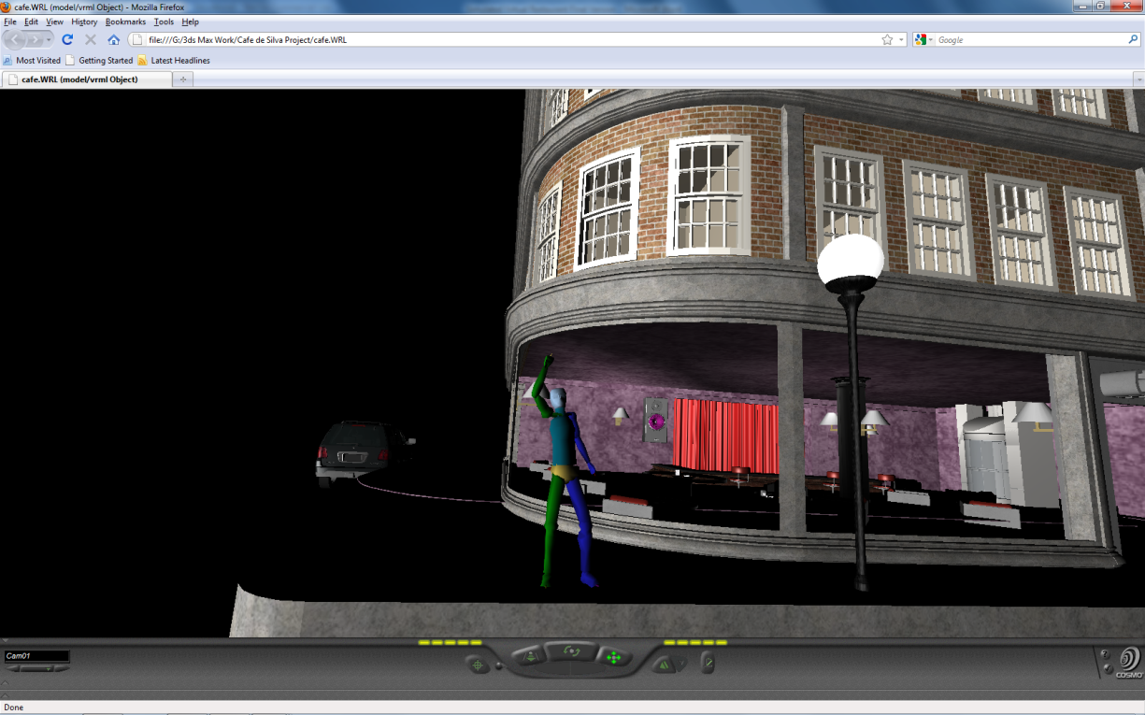
Biped

Slide 18
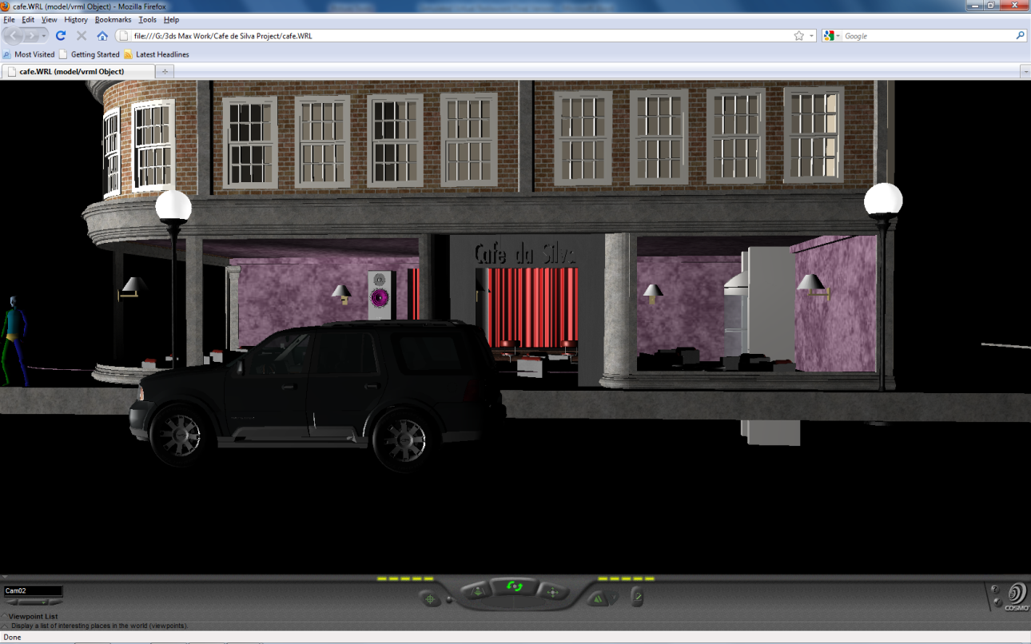
Vehicle

Slide 19
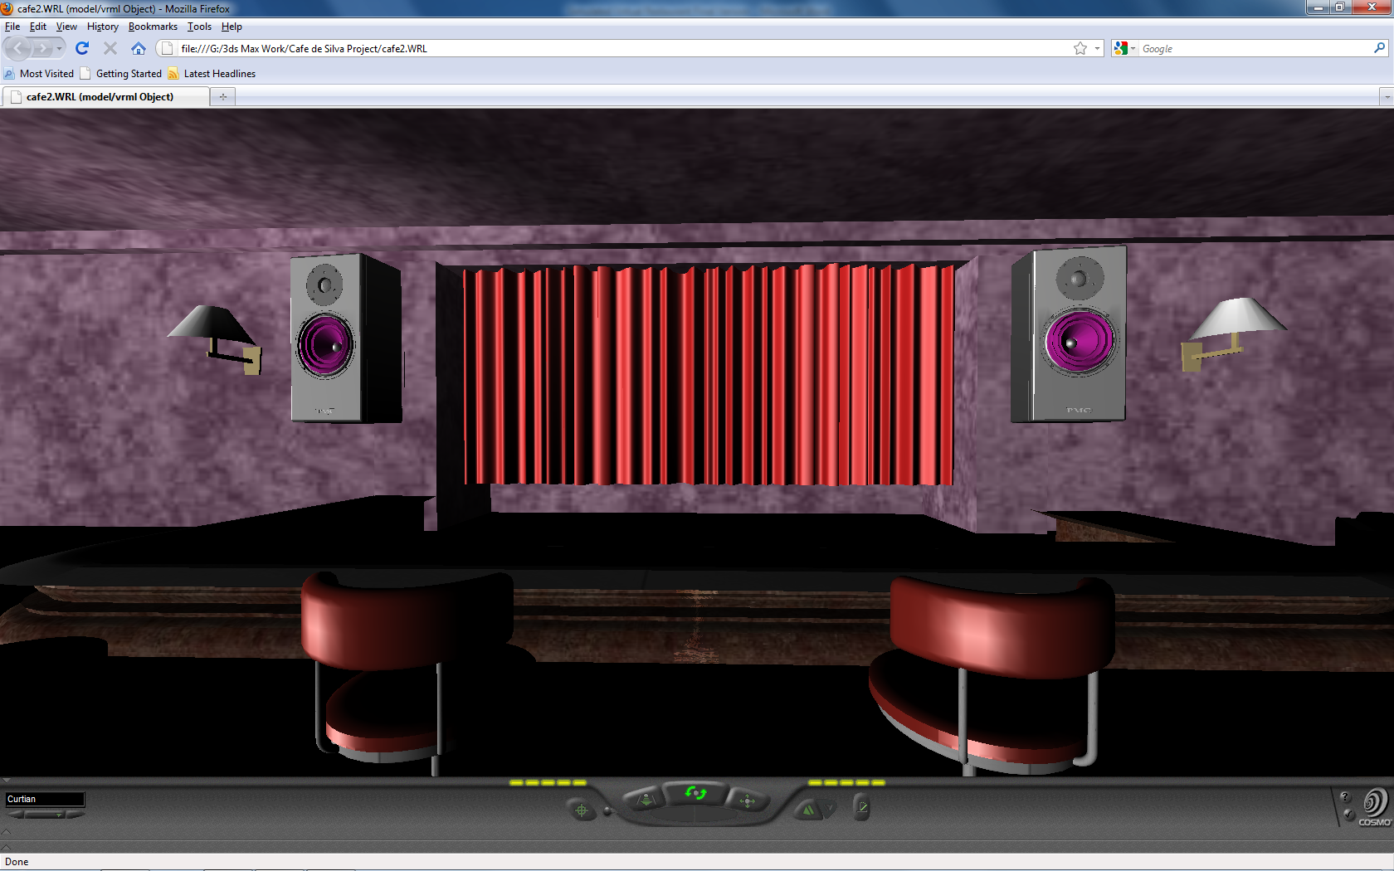
Speaker

Slide 20
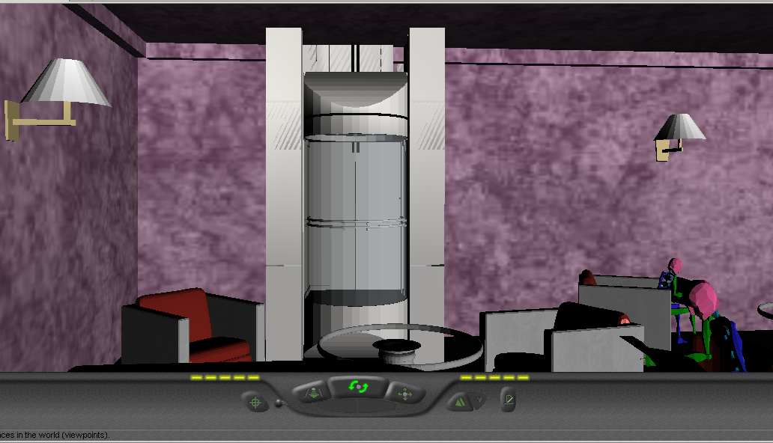
Elevator with VRML Touch Sensor

Slide 21
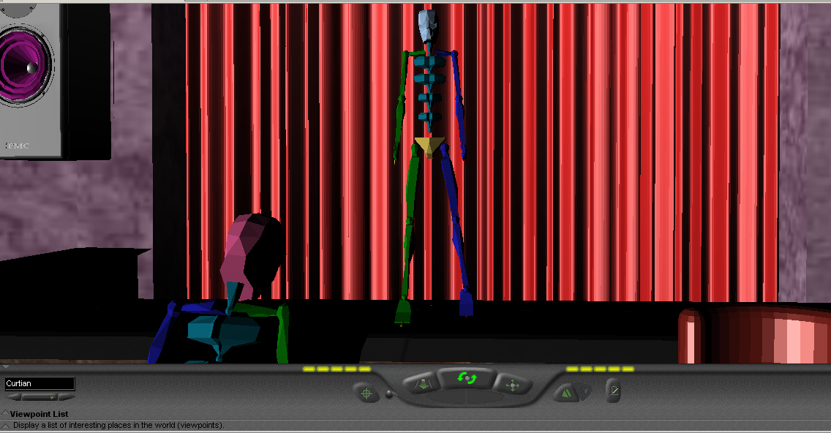
Curtain with VRML Touch Sensor

Slide 22
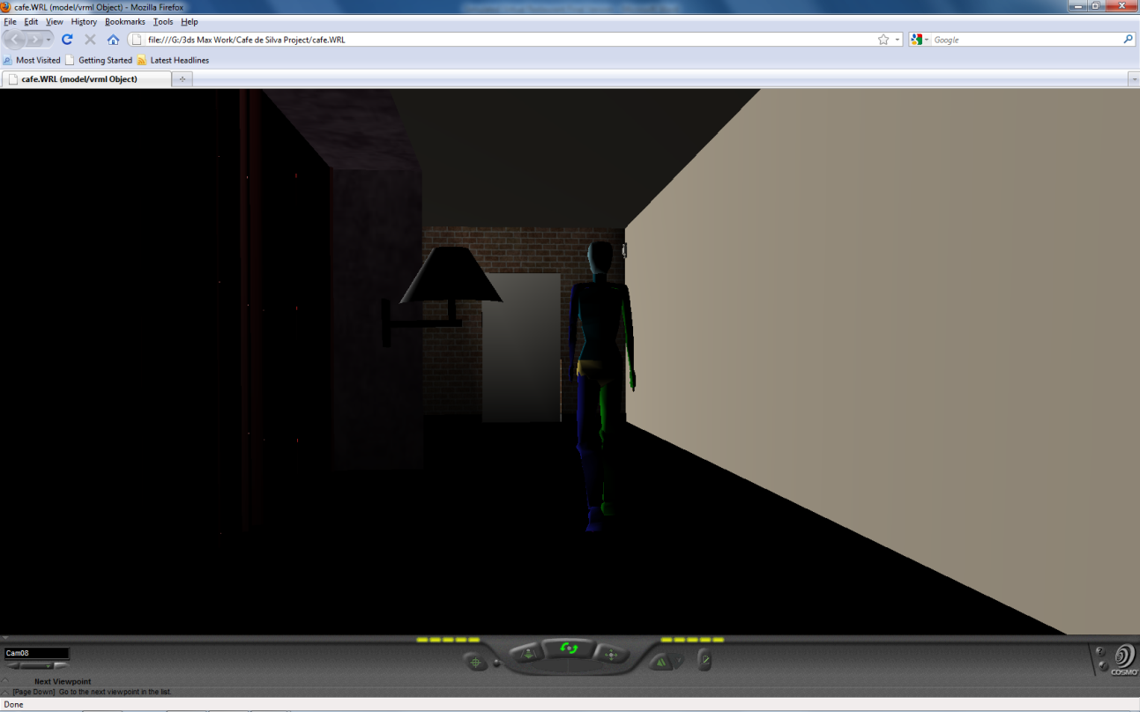
Door with VRML Touch Sensor

Slide 23
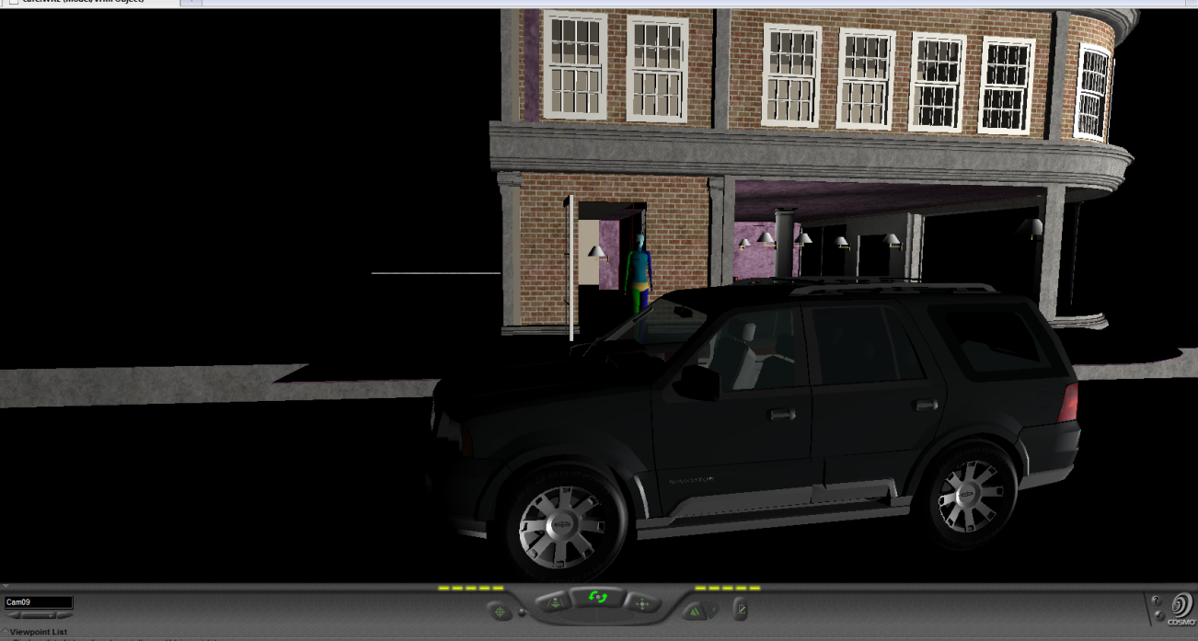
Door with VRML Touch Sensor

Slide 24
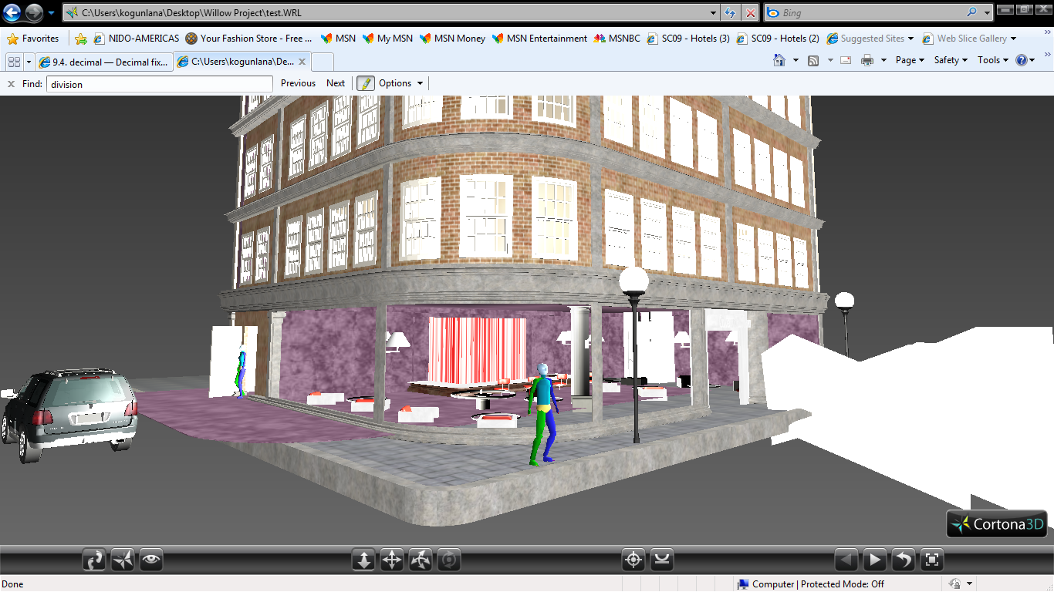
Crowd Behavior outside restaurant

Slide 25
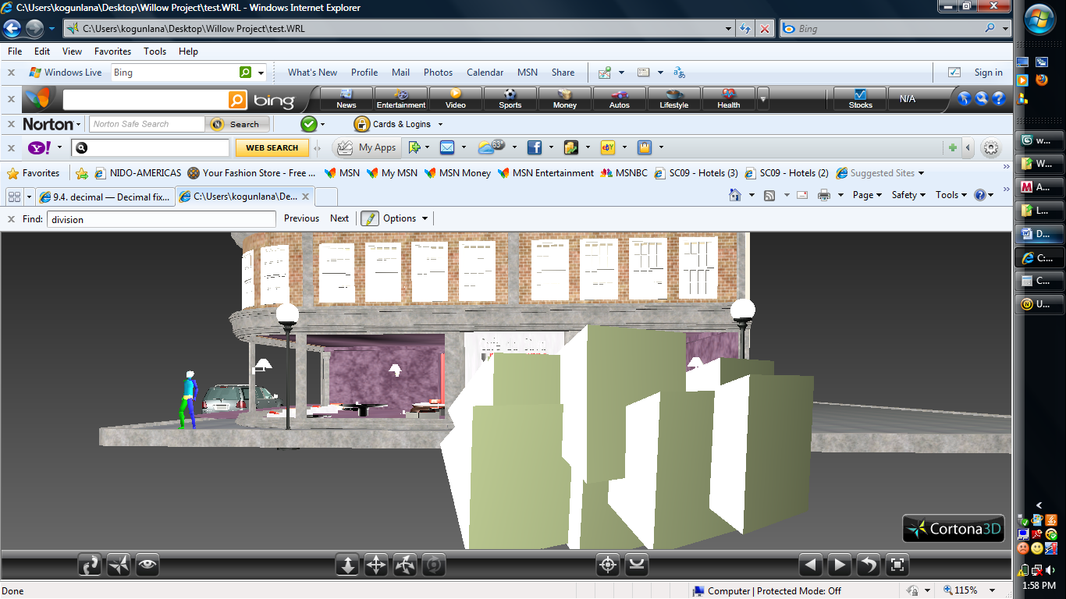
Crowd Behavior outside restaurant

Slide 26
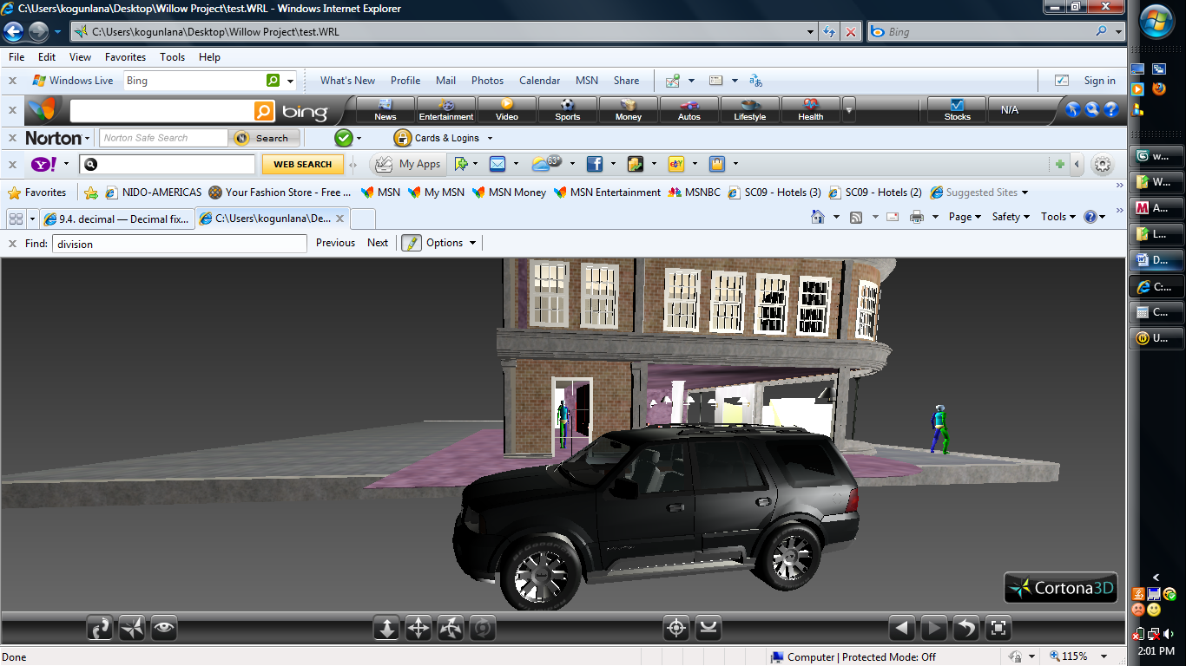
Crowd Behavior outside restaurant

Slide 27
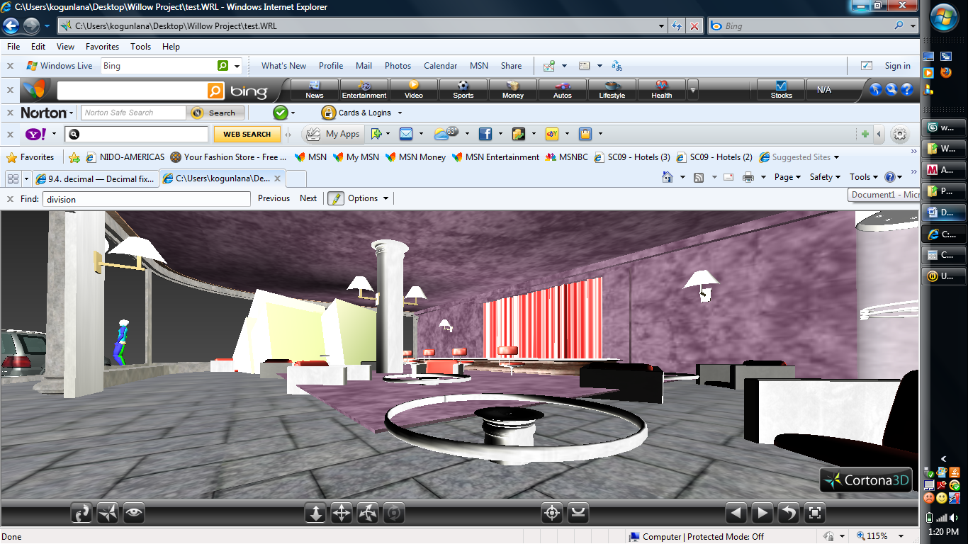
Crowd Behavior inside restaurant

Slide 28
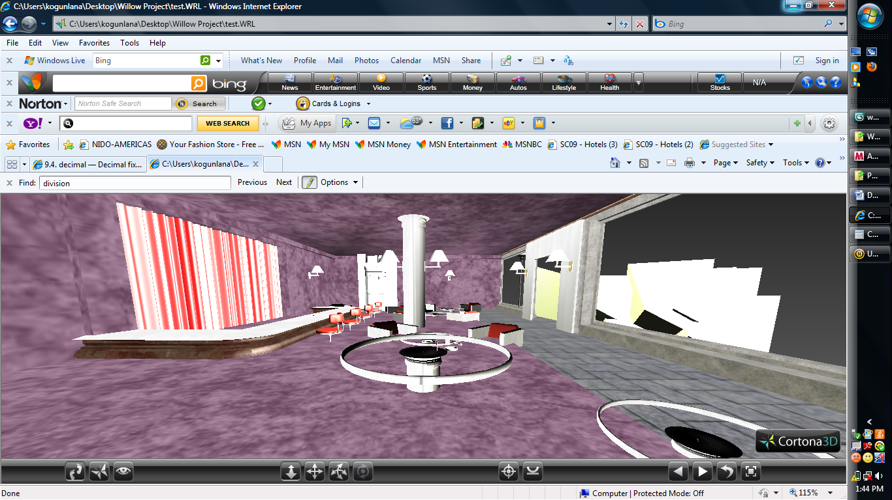
Crowd Behavior inside restaurant

Slide 29
Advantages and Barriers
Advantages of Adopting VR Restaurant Modeling
Enhanced communication and easy to explore restaurant context
Freedom of movement (movement between different scales and levels of details)
Different levels of immerseveness.
Ability to attach qualitative data to the models
Portability
Notes:
Quantitative – represented as numbers
Qualitative – data that can be observed but not measured
Immersiveness – the ability for the image to appear to surround the user

Slide 30
Advantages and Barriers
Barriers of Adopting VR Restaurant Modeling
Technical Issues
Organizational Issues
Ownership of the models
Privacy and security
Time constraints
Notes:
Quantitative – represented as numbers
Qualitative – data that can be observed but not measured
Immersiveness – the ability for the image to appear to surround the user

Slide 31
Conclusion
Notes:
Quantitative – represented as numbers
Qualitative – data that can be observed but not measured
Immersiveness – the ability for the image to appear to surround the user

Slide 32
References
http://www.renderosity.com
http://thefree3dmodels.com
http://www.vrmlsite.com
http://www.emory.edu/BUSINESS/vr.html
http://usa.autodesk.com
Notes:
Quantitative – represented as numbers
Qualitative – data that can be observed but not measured
Immersiveness – the ability for the image to appear to surround the user

Slide 33
Demo
Notes:
Quantitative – represented as numbers
Qualitative – data that can be observed but not measured
Immersiveness – the ability for the image to appear to surround the user

